Slide 1
Web Programming: HTML, CSS, JS, PHP
Liangqin Ren
EECS 348: Software Engineering

Slide 2
What is HTML
HTML (Hyper Text Markup Language), is a language used to build Web pages
Using HTML, you can build a Web page with text, graphics, sound, and video
The essence of HTML programming is tags
A tag is a keyword enclosed by angle brackets
There are opening and closing tags
The affected text is between the two tags
Tag commands can be in lower or uppercase
Tags can be nested

Slide 3
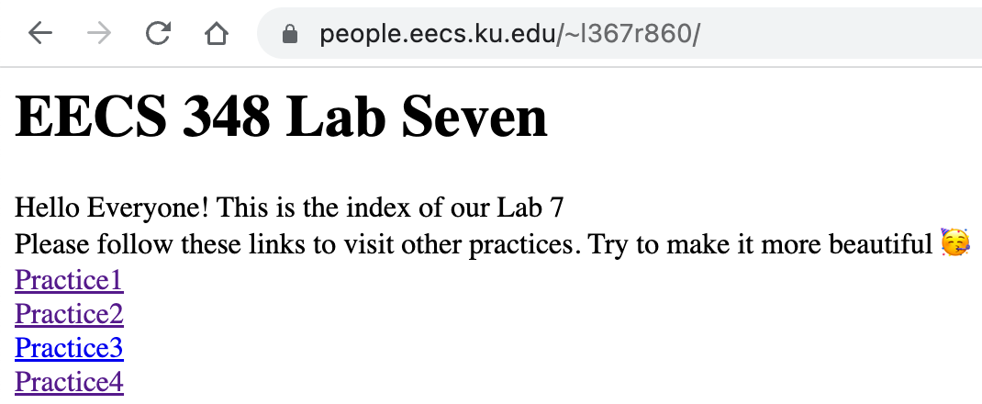
A Real example of HTML
<html>
<head>
<h1>EECS 348 Lab Seven</h1>
</head>
<body>
Hello Everyone! This is the index of our Lab 7<br>
Please follow these links to visit other practices. Try to make it more beautiful 🥳<br>
<a href="practice1.html">Practice1</a> <br>
<a href="practice2.html">Practice2</a> <br>
<a href="practice3.html">Practice3</a> <br>
<a href="practice4.html">Practice4</a> <br>
</body>
</html>

Slide 4
Insert images
Type <IMG SRC = “image.png”>, where image. png indicates the location of the image file, it could be a local picture or a website picture URI
The WIDTH=n and HEIGHT=n attributes can be used to adjust the size of an image
The attribute BORDER=n can be used to add a border n pixels thick around the image

Slide 5
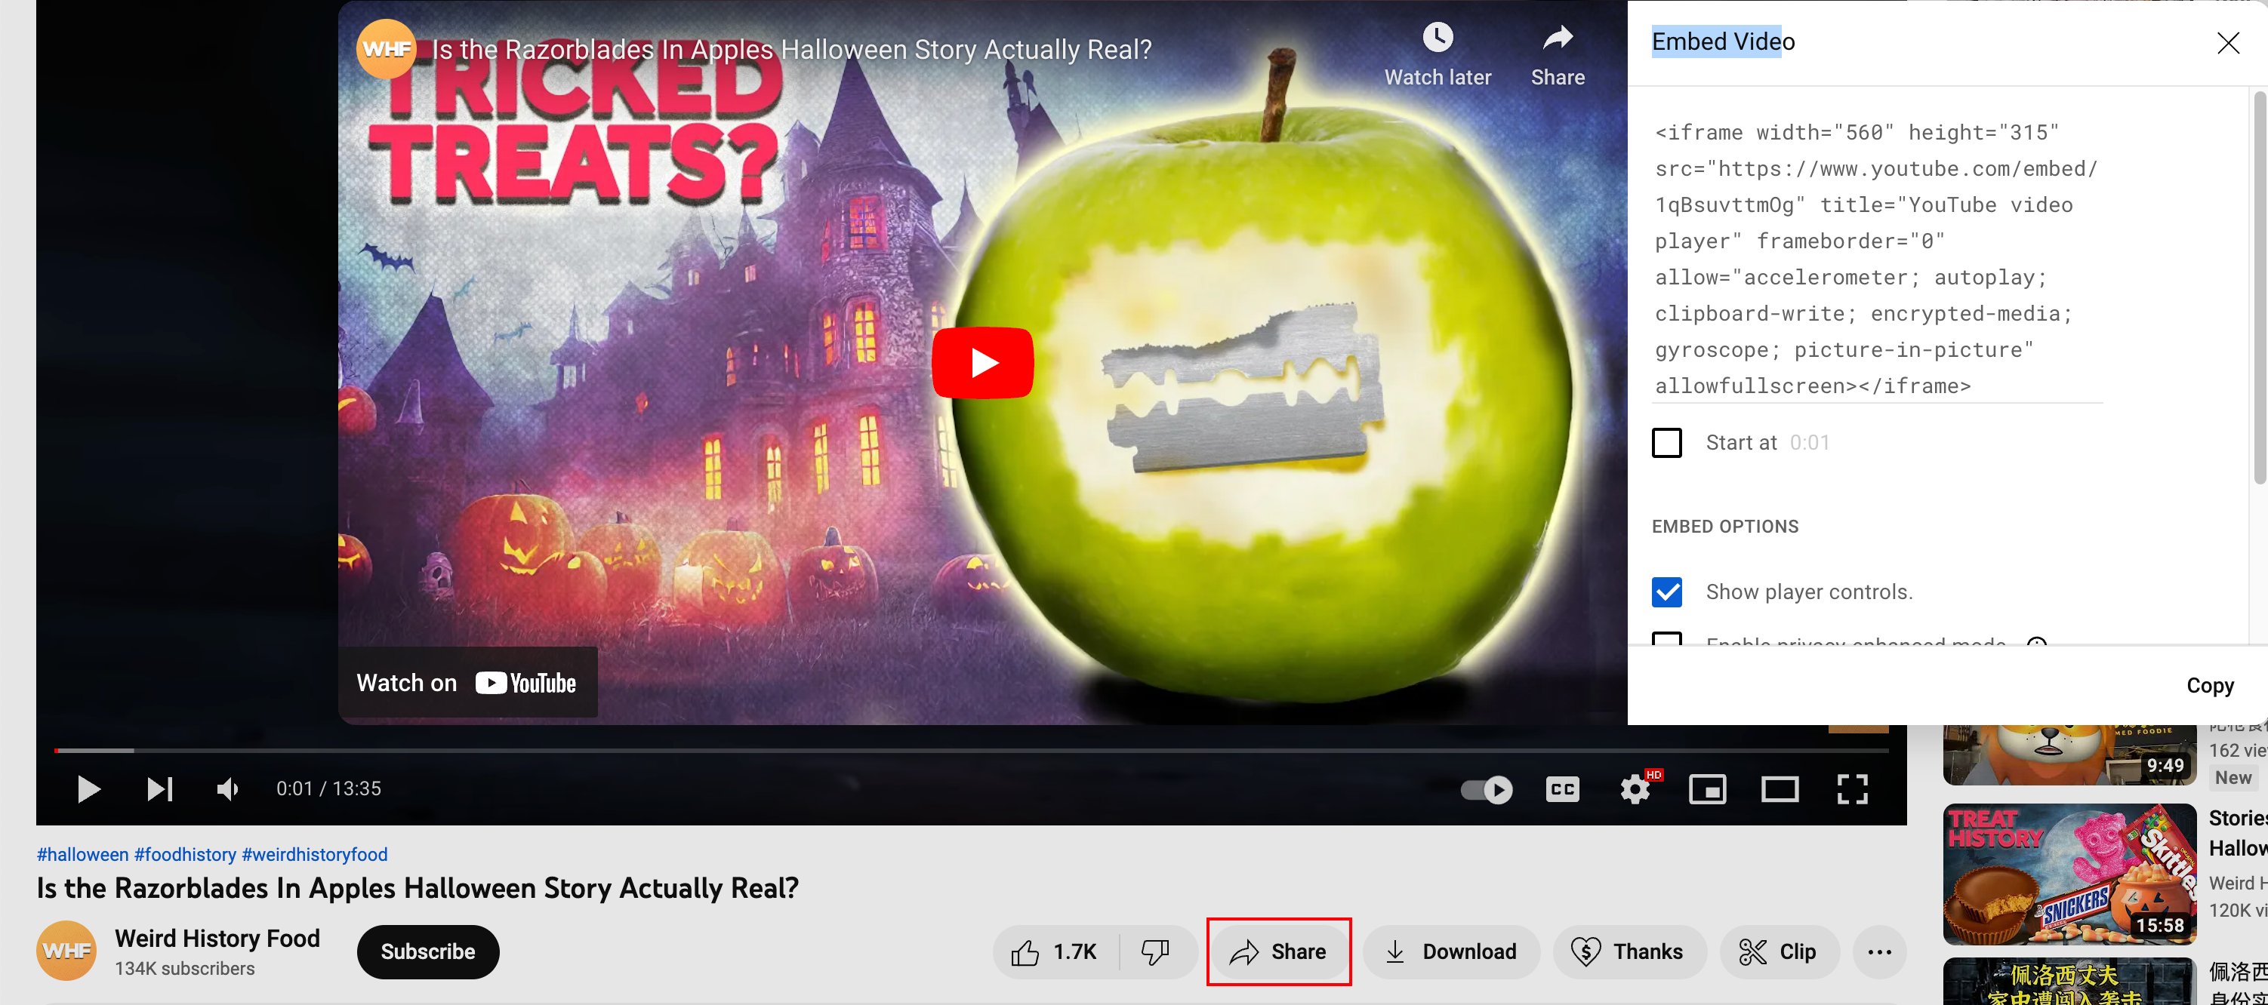
Insert videos
How to insert complex things like a video?
Some websites offer the codes for you, just use it!

Slide 6
Links
A link lets you move from one page to another, play movies and sound, send email, download files, and more….
A link has three parts: a destination, a label, and a target
To create a link type
<A HREF=“page.html”> label </A>
The label is the text that will appear underlined or highlighted on the page

Slide 7
What is JavaScript?
A lightweight programming language ("scripting language")
used to make web pages interactive
insert dynamic text into HTML (ex: user name)
react to events (ex: page load user click)
get information about a user's computer (ex: browser type)
perform calculations on user's computer (ex: form validation)
A web standard (but not supported identically by all browsers)
NOT related to Java other than by name and some syntactic similarities

Slide 8
Linking to a JavaScript file: script
<script src="filename" type="text/javascript"></script>
Script tag should be placed in HTML page's head
Script code is stored in a separate .js file
JS code can be placed directly in the HTML file's body or head (like CSS)
but this is bad style (should separate content, presentation, and behavior

Slide 9
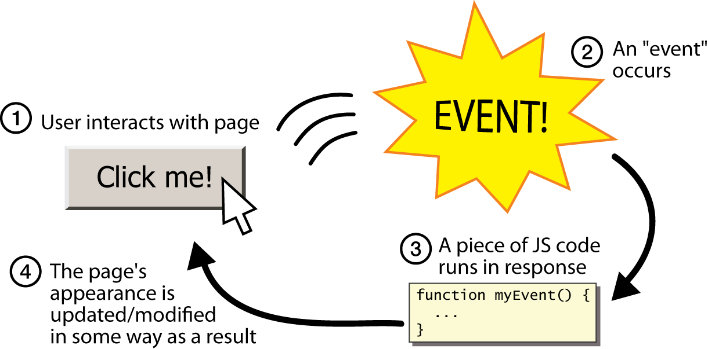
Event-driven programming

Slide 10
Get user input
HTML <input type=“text” id=“input” value=“”>
Id is very important, JS use id to identify the variable to read or to write in HTML
JS var input = document.getElementById(“input”).value;
JS document.getElementById(“input”).value = input;

Slide 11
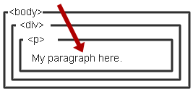
What is CSS?
Cascading Style Sheet
Stylesheet Language
Standards-based set of properties and attributes to define styles
To describe the presentation a document written in a ‘markup language’ like HTML or XML
Markup encoding: <p>My paragraph here.</p>
Defines the style of how things in <p> tags appear.
Font, color, size, margins, etc.
Cascading
Rules to determine how to
apply markup that contains
other markup

Slide 12
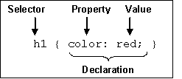
CSS syntax
3 Elements to a CSS Statement
Selector
What HTML sections does it affect?
Property
What attribute of that HTML section will be affected?
Value
What change will be made to that attribute?

Slide 13
Why CSS
Separate Content from form
Specify the style once for every instance of that class.
Example: Specify the font once for all text on the HTML page that you’ve identified as a “header”
The stylesheet can be a separate file which all HTML pages on your entire site can link to.
Only have to specify the style once for your ENITRE SITE
Can change the style for your entire site by editing only ONE FILE.

Slide 14
Why CSS?
Separate Content from Form
Content is the text and images, marked up to define regions of specific types
Form defines the “style” for the content
<font size=“14px”>
My First Header
</font>
<font size=“12px” color=“red” face=“Verdana”>
My information 1 goes here.
</font>
<font size=“14px”>
My Second Header
</font>
<font size=“12px” color=“red” face=“Verdana”>
Different information goes here.
</font>
The old way:

Slide 15
Why CSS?
Separate content from form
Content
Form or Style
<div id=“paragraph”>
Paragraph to be altered.
</div>
<style>
#paragraph {
border-style: solid;
border-width: 10;
background-color: burlywood;
color: black;
font-size: 18pt;
background-image: url(””);
}
</style>

Slide 16
Three CSS definition locations
Inline: the “style” attribute
Note, the selector for inline CSS is the tag that contains the style attribute
Internal: the <style> markup tag
External: the .css stylesheet file
<p style=“font-color:red;font-size:10px;”>Content</p>
<html><head><style>
p { background-color: Red;
font-family: serif;
font-color: White; }
</style></head><body>
<p>Content</p> </body></html>
<link rel="stylesheet" type="text/css" href=“mystylesheet.css" />

Slide 17
CSS syntax: selectors
There are many kinds of selectors and many ways to reference them:
Type, Class, ID, Pseudo, etc.
HTML Type Tag – selected with the tag type
The Class Attribute – precede the class with a period
p { font-size: 10px;
font-color: White; }
<p>Content</p>
.myinfo { font-size: 10px;
font-color: White; }
<p class=“myinfo”>Content</p>
<div class=“myinfo”>Other content</div>

Slide 18

PHP
A widely-used open-source scripting language
Free to download (php.net)
Stands for Hypertext Preprocessor
PHP scripts are executed on the server side
Not on a local machine (unless PHP is installed, and you are running a local webserver)

Slide 19
PHP files
Have a default .php file extension
May contain text, HTML, JavaScript, and PHP code
PHP code is executed on the server, and the result is returned to the browser as plain HTML

Slide 20
Why PHP?
PHP runs on different platforms (Windows, Linux, Unix, Mac OS X, etc.)
PHP is compatible with almost all servers (Apache, IIS, etc.)
PHP has support for a wide range of databases
PHP is relatively easy to learn and runs efficiently on the server side
Lots of built-in functionality; familiar syntax
PHP is well-documented:
Type php.net/functionName in browser address bar to get docs for any function

Slide 21
Basic syntax
A PHP script starts with <?php and ends with ?>
<?php // PHP code goes here ?>
The default file extension for PHP files is ".php".
A PHP file normally contains HTML tags, and some PHP scripting code
Each code line in PHP must end with a semicolon
The semicolon is a separator and is used to distinguish one set of instructions from another
Two statements to output: echo and print

Slide 22
PHP variables
Variable names start with $ followed by the name
A variable name must begin with a letter or the underscore character
A variable name can only contain alphanumeric characters and underscores (A-z, 0-9, and _ ) and no spaces
Variable names are case sensitive ($y and $Y are two different variables)

Slide 23
For loop (similar to Java)
for (initialization; condition; update) {
statements;
}
Example
for ($i = 0; $i < 10; $i++) {
print "$i squared is " . $i * $i . ".\n";
}

Slide 24

In the future
Use the existing framework rather than writing HTML files by yourself.
Markdown + GitHub + Hugo/Hexo/Jekyll + (Netlify)

